Slide 1

Tutorial on IQM Tools Lite
General Model Specification, Simulation, etc.
Integrated Solutions for Quantitative Drug Development
From Mechanistic Models to Complex Trial Simulation
Henning Schmidt, IntiQuan GmbH
1

Slide 2
Tutorial Outline
General introduction to the IQM Tools Suite
Model definition and simulation
  ODE based models
  Biochemical reaction equation based models
  Import and export of models (SBML, etc.)
  Simple simulation and analysis of models
  Commenting of models
Model analysis
  Steady-state analysis and stability
  Moiety conservations and reduction
  Parameter sensitivity analysis (steady-state & oscillating systems, MCA, local & global)
  Localization of complex behaviors

Slide 3
Tutorial Outline
Model and dosing descriptions
  Setup models to define dosing inputs
  Dosing description
  Simulation of dosing scenarios
Definition of experiments and measurement data
  Excel and CSV measurement representation
  Experiment descriptions and merging with models
  Import and export measurements and experiments

Slide 4
Tutorial Info
In large parts you will have the opportunity to get hands-on-experience
>> installIQMtoolsInitial
Commands shown in these boxes should be entered on the MATLAB
command line, during the tutorial
********** MODEL NAME
Simple model
********** MODEL STATES
d/dt(A) = -R
d/dt(B) = R
A(0) = 1
B(0) = 0
********** MODEL PARAMETERS
k1 = 0.5
********** MODEL REACTIONS
R = k1*A
Text shown in these boxes should
be entered where appropriate
(will become clear later)

Slide 5
Tutorial Goal: „You should be able to“
Define models using ODEs and/or biochemical reactions
Simulate and analyze models
Simulate models for defined dosing inputs
Define and simulate experiments on models
Define measurement data, import, export, plotting

Slide 6
Tutorial Outline
General introduction to the IQM Tools Suite
Model definition and simulation
Model analysis
Model and dosing descriptions
Definition of experiments and measurement data

Slide 7
Introduction to the “IQM Tools Suite”
The IQM Tools Suite is provided freely and as open source
The IQM Tools Suite consists of two main packages
  IQM Tools Lite
  IQM Tools Pro
The whole is based on MATLAB (www.mathworks.com)
IQM Tools Lite
Model, experiment, measurement & dosing representation, simulation, analysis functions, optimization, signal processing, statistical functions, etc.
IQM Tools Pro
Systems biology/pharmacology and PMX functionality, clinical data analysis, nonlinear mixed effect modeling, clinical trial simulations, high speed simulation through transparent C-code interface

Slide 8
Modular Design of the IQM Tools Suite
MONOLIX
NONMEM
IQM Tools Pro (pmx) (population PKPD, workflows, trial simulation, ...)
IQM Tools Pro
(sys)
(parameter
determination
functionality)
GUI Functions
(Model editing, visualization, etc.)
IQM Tools Lite
Functions
(Analysis, Simulation, etc.)
Optimization
Algorithms
SUNDIALS
CVODES
Powerful
Solvers
Low-Level Functions
(creating, converting objects)
Signal Processing
functions
Statistical
functions
IQMprojectSB
IQMmodel / IQMmeasurement
IQMexperiment/IQMdosing
SBML
Toolbox
MEX
MATLAB
ODE FILE
..., ..., ...

Slide 9
Requirements
MATLAB R2013b (or later)
  Model reduction methods require the Symbolic Toolbox
  Availability of the Parallel Toolbox useful for the Pharmacometric functions in IQM Tools Pro
Optional 3rd party software
  Monolix Version 4.2.3 (or later) (http://www.lixoft.org)
  NONMEM Version 7.2 (or later) (http://www.iconplc.com)
  SSm Global Optimization Toolbox (http://www.iim.csic.es/~gingproc/ssmGO.html)
  SBML Toolbox (http://sbml.org/Software/SBMLToolbox)
    Only needed for Unix/Linux/Mac
    For Windows it is included in the distribution of the IQM Tools Lite

Slide 10

Where to get IQM Tool Suite from?
Free download of IQM Tools Suite available from the IntiQuan webpage
The IQM Tools Suite is distributed as a ZIP file with both IQM Tools Lite and IQM Tools Pro included
Unzip this ZIP file on your computer at a location where you want to store the IQM Tools
www.intiquan.com

Slide 11
How to Install the IQM Tool Suite?
Start MATLAB
Change into the “IQM Tools Suite” folder
Read and update custom information in setup files:
  IQMlite/SETUP_PATHS_TOOLS_IQMLITE.m
  IQMpro/SETUP_PATHS_TOOLS_IQMPRO.m
Execute the “installIQMtoolsInitial” script
You need to execute the “installIQMtoolsInitial” script once after obtaining a copy of IQM Tools. This will compile required libraries.
After this first installation, you can use the function “installIQMtools” to install IQM tools. This needs to be done each time you exit and start MATLAB again. This is on purpose for compliance and reproducibility reasons.
If you do not care about compliance, you might want to consider the use of a startup.m script (see http://www.mathworks.com/help/matlab/ref/startup.html).

Slide 12
Installation of optional 3rd party software
Please follow the providers instructions when installing optional 3rd party software.

Slide 13
IQM Tools’ Documentation
  MATLAB style help
IQM Tools Tutorials with examples
  Part 1: IQM Tools Lite (General Model Specification, Simulation, etc.)
  Part 2: IQM Tools Pro (MEX / Systems Biology/Pharmacology Projects)
  Part 3: IQM Tools Pro (Basic Pharmacometrics)
  Part 4: IQM Tools Pro (General Dataset Specification and PMX Workflows)
  Part 5: IQM Tools Pro (Advanced Clinical Trial Simulations)
  Part 6: IQM Tools Pro (Linking Systems Pharmacology Models to Clinical Data)
  IQM Tools – Workshops
    Given on demand and on some conferences during a year
>> help IQMlite
>> help IQMpro
>> help IQMsimulate
>> help IQMexportCSVdataset
>> doc IQMlite
>> doc IQMsimulate

Slide 14
Tutorial Outline
General introduction to the IQM Tools Suite
Model definition and simulation
  ODE based models
  Biochemical reaction equation based models
  Import and export of models (SBML, etc.)
  Simple simulation and analysis of models
  Commenting of models
Model analysis
Model and dosing descriptions
Definition of experiments and measurement data

Slide 15
ODE based models
IQMmodel

Slide 16
A First Model
Creating a first model
A ––R––> B R = k1*A
A(0) = 1, B(0) = 0 k1 = 0.5
>> model = IQMmodel() % creating empty model
>> model = IQMedit(model) % editing the model
>> model = IQMedit() % starting the editor with an empty model

Slide 17
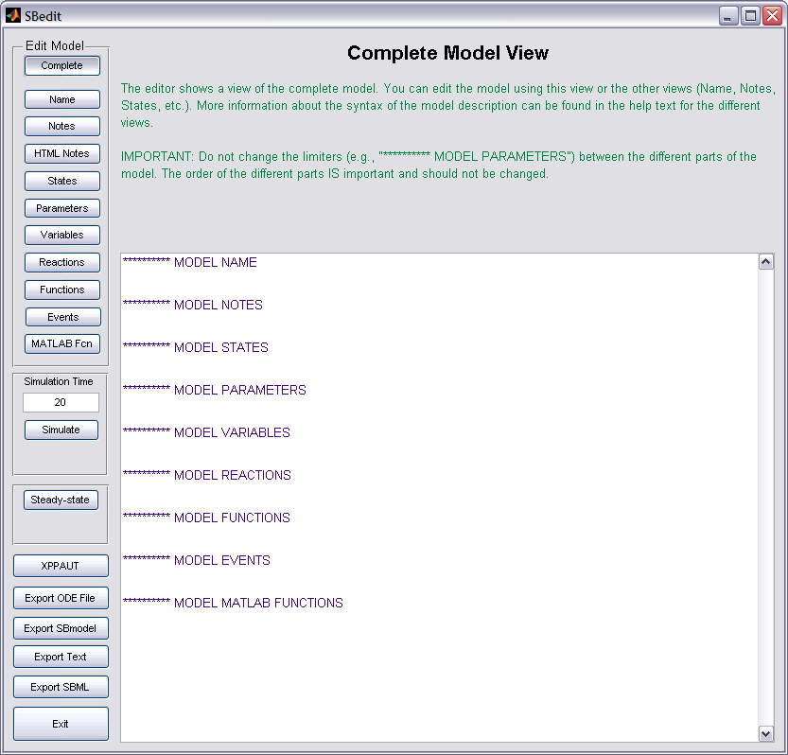
IQMedit
Graphical User
Interface allowing to
edit models
Click on the
”Edit Model” buttons
Each view provides
a help text about the
model syntax
The limiters are
important – do not
change them

Slide 18
Simple ODE Model (States, Parameters, Reactions)
Enter the following information (keep all non-used limiters)
********** MODEL NAME
Simple model
********** MODEL STATES
d/dt(A) = -R
d/dt(B) = R
A(0) = 1
B(0) = 0
********** MODEL PARAMETERS
k1 = 0.5
********** MODEL REACTIONS
R = k1*A
A –R–> B
A(0) = 1
B(0) = 0
k1 = 0.5
R = k1*A
Click ”Simulate”

Slide 19
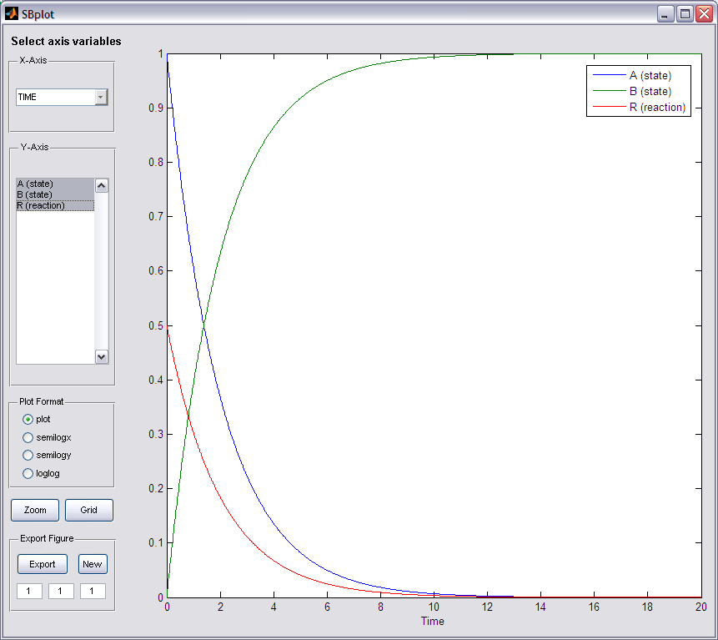
Simulate Simple Model
IQMplot
Graphical User Interface
for the display of time series
type of data
Play around with the features
of the plotting window

Slide 20
Model Functions
Model functions can be used to define often recurring calculations
********** MODEL STATES
d/dt(A) = -R
d/dt(B) = R
A(0) = 1
B(0) = 0
********** MODEL PARAMETERS
k1 = 0.5
********** MODEL REACTIONS
R = k1*f(A)
********** MODEL FUNCTIONS
f(x) = x^3
A –R–> B
A(0) = 1
B(0) = 0
k1 = 0.5
R = k1*f(A)
f(x) = x^3
Click ”Simulate”

Slide 21
Model Events
Model events can be used to define discrete state events
********** MODEL STATES
d/dt(A) = -R
d/dt(B) = R
A(0) = 1
B(0) = 0
********** MODEL PARAMETERS
k1 = 0.5
********** MODEL REACTIONS
R = k1*f(A)
********** MODEL FUNCTIONS
f(x) = x^3
********** MODEL EVENTS
event = lt(A,0.3), A, 1, B, 0
If A becomes less than 0.3 then reset A to 1 and B to 0
Click ”Simulate”

Slide 22
Model Variables
Simulation of these two models gives exactly the same results
********** MODEL NAME
Simple model
********** MODEL STATES
d/dt(A) = -R
d/dt(B) = R
A(0) = 1
B(0) = 0
********** MODEL PARAMETERS
k1 = 0.5
********** MODEL REACTIONS
R = k1*A
********** MODEL NAME
Simple model
********** MODEL STATES
d/dt(A) = -R
d/dt(B) = R
A(0) = 1
B(0) = 0
********** MODEL PARAMETERS
k1 = 0.5
********** MODEL VARIABLES
R = k1*A
So what is the difference?

Slide 23
Model Reactions vs. Model Variables
Reaction rates should be defined under MODEL REACTIONS
Variables for intermediate calculations (or for monitoring) should be defined under MODEL VARIABLES
The only cases where it matters for the toolbox is when
  Determining the stoichiometric matrix
  Exporting the model to SBML

Slide 24
Command Line Simulation
Clicking ”Exit” in the IQMedit GUI returns the model to the workspace
>> model = IQMedit()
IQMmodel
========
Name: Simple Model
Number States: 2
Number Variables: 0
Number Parameters: 1
Number Reactions: 1
Number Functions: 1
Number Events: 1
>> IQMsimulate(model,50) % simulation over 50 time units

Slide 25
Command Line Simulation, continued
>> output = IQMsimulate(model,50)
output =
time: [50x1 double]
states: {'A' 'B'}
statevalues: [50x2 double]
variables: {}
variablevalues: []
reactions: {'R'}
reactionvalues: [50x1 double]
>> help IQMsimulate

Slide 26
Array specification of TEXT IQMmodels

Slide 27
Array specification of TEXT IQMmodels
Consider a system that can be described by the following set of differential equations:
d/dt x[n] = kon*x[1]*x[n-1] + koff*x[n+1] - (kon*x[1]+koff)*x[n], n=1…N
  Example:
    Model for the length distribution of actin filaments, Edelstein-Keshet, Mathematical Biology, 1998
If N is large it is very messy to type all these differential equations in by hand. Here, the array type model specification of IQMmodels helps in setting up such equations

Slide 28
Array specification of TEXT IQMmodels
Example
********** MODEL STATES
d/dt(x<n,0>) = 0
d/dt(x<n,1:N>)= kon<n>*x<1>*(x<n-1>) + koff*x<n+1> - (kon*x<1>+koff)*x<n> + R<n>
d/dt(x<n,N+1>) = 0
x<n,[1:2, 4:N]>(0) = n*N
x<n,3>(0) = 100
x<n,N+1>(0) = 0
********** MODEL PARAMETERS
N = 10
koff = 2
kon = 0.01
********** MODEL VARIABLES
kon<k,1:N> = kon*sqrt(k)
SUMEXAMPLE1 = 5 + arraysumIQM(n^2/(x<n,1:N> + n/N))+ 56
SUMEXAMPLE2 = arraysumIQM(x<n,1:N>)
SUMEXAMPLE3 = arraysumIQM(x<n,[1,3,5]>)
SUMEXAMPLE4 = arraysumIQM(x<n,[1:2:N-1]>)
********** MODEL REACTIONS
R<n,1:N> = koff*x<n+1> - kon<n>*x<n>*N*n
Simple to use format
ODEs, variables, and
reactions can be
defined by arrays
Negative indices
possible
arraysumIQM is a
powerful and general
construct to determine
sums etc. over desired
array elements
During import of such
a model the array
notation is expanded
...

Slide 29
Array specification of TEXT IQMmodels
Example
The expansion of the array notation is best understood by running an example (change into the „Example Files“ folder):
Now change „N“ in the array.txt file to N=100 and save the file
You see the difference?
>> edit array.txt % opens the model file as seen in the previous slide
>> model = IQMmodel('array.txt') % import the model
>> IQMedit(model) % look at the model and compare to array.txt
>> edit array.txt % opens the model file as seen in the previous slide
>> model = IQMmodel('array.txt') % import the model
>> IQMedit(model) % look at the model and compare to array.txt

Slide 30
Array specification of TEXT IQMmodels
Example
Array-type notation and standard ODE specification can be combined
More information about the array notation can be found in the
array_notation_explained.txt model in the „Example Files“ folder

Slide 31
Biochemical reaction equation based models
IQMmodel

Slide 32
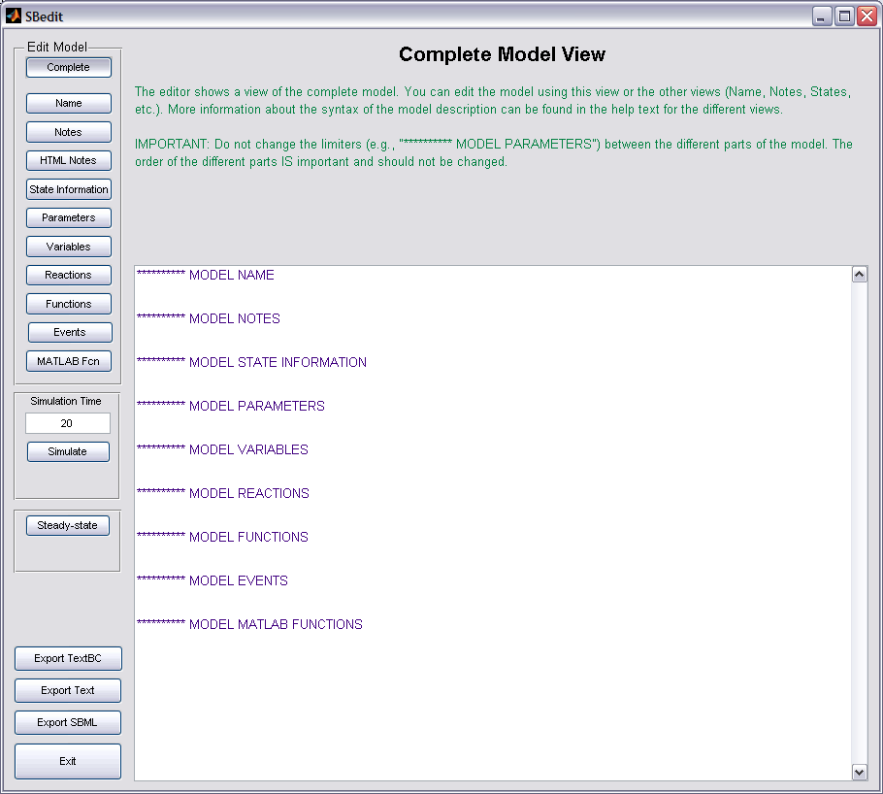
Modeling Using BioChemical Reaction Equations
>> model = IQMeditBC()
IQMeditBC
Graphical User Interface
allowing to edit models
based on reaction equations
Click on the
”Edit Model” buttons
Each view provides
a help text about the
model syntax
The limiters are
important – do not
change them

Slide 33
Simple Model Again ...
Enter the following information (keep all non used limiters)
********** MODEL NAME
Simple model
********** MODEL STATE INFORMATION
A(0) = 1
B(0) = 0
********** MODEL PARAMETERS
k1 = 0.5
********** MODEL REACTIONS
A => B : R
vf = k1*A
A –R–> B
A(0) = 1
B(0) = 0
k1 = 0.5
R = k1*A
Click ”Simulate”

Slide 34
More Complex Model
********** MODEL STATE INFORMATION
B(0) = 1
********** MODEL PARAMETERS
k1 = 0.5
********** MODEL REACTIONS
A+B => 2*C : R1
vf = k1*A*B
B <=> A+D : R2
vf = 5.1*B
vr = 3*A*D
2*A => A2 : R3
vf = 2.7*A^2
Click ”Simulate”
Click ”Exit”
=> Interchangeable formats
>> model = IQMedit(model)

Slide 35
Import/Export of models
  Textual description
  SBML

Slide 36
Export a Model to the Textual Descriptions
To export a model to the ODE / Biochemical textual description using IQMedit or IQMeditBC click ”Export Text” / ”Export TextBC”
  Choose a file name – here: textmodel.txt / textmodel.txtbc
  ODE textmodel files are required to have the extension .txt
  Biochemical textmodel files are required to have the extension .txtbc
  Click ”Exit”
Export by command line commands
>> IQMedit(model) % the variable “model” contains a model from the previous work
>> IQMcreateTEXTfile(model, 'textmodel') % saves model as “textmodel.txt”
>> IQMcreateTEXTBCfile(model, 'textmodel') % saves model as “textmodel.txtbc”

Slide 37
Import a Textual Description to an IQMmodel
Open the TEXT(BC) model file with the MATLAB editor to see its syntax
To import the TEXT(BC) model and convert it to an IQMmodel write
>> edit textmodel.txt
>> edit textmodel.txtbc
>> model = IQMmodel('textmodel.txt') % the IQMmodel command loads a model in txt
>> model = IQMmodel('textmodel.txtbc') % and in txtbc format. The extensions are important!

Slide 38

Import of SBML Models
SBML Level Version 1,2,3 & 4 models can be imported
The SBML Toolbox needs to be present
Change into the ”Example Files” folder
>> model = IQMmodel('CellCycle.xml') % IQMmodel additionally also import SBML models
IQMmodel
========
Name: CellCycle
Number States: 13
Number Variables: 2
Number Parameters: 41
Number Reactions: 23
Number Functions: 0
>> IQMedit(model)
Increase simulation time to 400 and click ”Simulate”

Slide 39
Import of SBML Models
Import of Incompletely Defined SBML Models
Per default IQM Tools requires an SBML model to be completely defined before it is correctly imported
To allow the user to import incompletely defined models the following optional call to IQMmodel exists:
  IQMmodel then does not require that an SBML model is fully defined in terms of parameter values, rate equations, kinetic parameters, etc.
  However, when trying to „Exit“ IQMedit or IQMeditBC model correctness is checked. To still exit on Windows click the red cross in the upper right corner of the window. On Unix/Linux/Mac also click the corresponding symbol ...
% File located in the “Example Files” folder
>> model = IQMmodel('SBMLfileIncomplete.xml',1);
>> IQMedit(model)

Slide 40
Import of SBML Models
Name to ID Conversion
'Name' to 'id' conversion
  E.g.: Not all models in Biomodels.net have informative IDs, and CellDesigner or Simbiology choose the ids of certain elements (e.g., species and reactions) automatically and the user only can choose names that need not be unique
  In IQM Tools the ids are used as names for states, variables, etc. (since they are unique)
  => an optional call to IQMmodel (see box below) allows to use the SBML names instead of the IDs, but making them unique by numerical extensions
  More information, see the help text:
********** MODEL REACTIONS
reaction_0000001 = compartment_0000002 * (parameter_0000027 * parameter_0000021 + parameter_0000031)
reaction_0000002 = compartment_0000001 * (parameter_0000028 * parameter_0000020 + parameter_0000032)
reaction_0000003 = compartment_0000001 * delay(parameter_0000029 * parameter_0000022 + parameter_0000034, parameter_0000039)
reaction_0000004 = compartment_0000001 * (parameter_0000030 * (power(species_0000009, 2) / (power(species_0000009, 2) + power(parameter_0000010, 2))) * (power(parameter_0000008, 2) / (power(species_0000007, 2) + power(parameter_0000008, 2))) + parameter_0000033)
>> model = IQMmodel('SBMLfileIncomplete.xml',1,1);
>> help IQMmodel

Slide 41
Export of SBML Models
Export only to SBML Level 2 Version 1
IQMmodels do not necessarily contain all needed information for export
  Additional information is required
Location of additional information (in IQMmodel internal data structure)
states.type algebraic.type
states.compartment algebraic.compartment
states.unittype algebraic.unittype
parameters.type variables.type
parameters.compartment variables.compartment
parameters.unittype variables.unittype
>> help IQMexportSBML % for more information on the additional information
*.type: 'isSpecie’ 'isParameter' 'isCompartment'
*.compartment: compartment - outside compartment
*.unittype: 'amount' or
'concentration' - -

Slide 42
Export of SBML Models
Additional Information in the TEXT Description
Additional information can
be added in the text / textbc
format
After SBML import the
additional information is
already present
********** MODEL NAME
example
********** MODEL NOTES
********** MODEL STATES
d/dt(s1) = -re1 {isSpecie:cytosol:amount} % comment
d/dt(s2) = +re1 {isSpecie:cytosol:amount}
d/dt(s3) = -re2+re4 {isSpecie:cytosol:amount}
d/dt(s4) = +re2-re5 {isSpecie:cytosol:amount}
d/dt(s5) = (-re3)/nucleus {isSpecie:nucleus:concentration}
d/dt(s6) = +re3 {isSpecie:nucleus:amount}
s1(0) = 1
********** MODEL PARAMETERS
s7 = 1 {isParameter} % comment
s8 = 1 {isParameter}
cytosol = 1 {isCompartment:}
nucleus = 0.1 {isCompartment:cytosol}
********** MODEL VARIABLES
********** MODEL REACTIONS
re1 = 3 * s1 - 2 * s2 {reversible} % comment
re2 = s3
re3 = s4 * (s5 - s6) {reversible}
re4 = 1
re5 = s4
>> help IQMedit
>> help IQMeditBC

Slide 43
Export of SBML Models
Automatic Determination of Additional Information
Even if no additional information is given, the toolbox is under certain conditions able to determine the correct information.
Remember: SBML assumes reaction rates defined in amount/time
Here it is important that the elements on the RHS are defined under the „MODEL Reactions“ header
novaktyson1.txt
novaktyson2.txt
d/dt(Cyclin) = R1-R2-R3
d/dt(YT) = R4-R5-R6-R7+R8+R3
d/dt(PYT) = R5-R8-R9-R10+R11
d/dt(PYTP) = R12-R11-R13-R14+R9
d/dt(MPF) = R6-R4-R12-R15+R13
d/dt(Cdc25P) = R16
d/dt(Wee1P) = R17
d/dt(IEP) = R18
d/dt(APCstar) = R19
d/dt(Cyclin) = (R1-R2-R3)/compartment
d/dt(YT) = (R4-R5-R6-R7+R8+R3)/compartment
d/dt(PYT) = (R5-R8-R9-R10+R11)/compartment
d/dt(PYTP) = (R12-R11-R13-R14+R9)/compartment
d/dt(MPF) = (R6-R4-R12-R15+R13)/compartment
d/dt(Cdc25P) = (R16)/compartment
d/dt(Wee1P) = (R17)/compartment
d/dt(IEP) = (R18)/compartment
d/dt(APCstar) = (R19)/compartment
=> Species in Amount units
=> Species in Concentration units

Slide 44
Export of SBML Models
Automatic Determination of Additional Information
Example
Have a look at both files (novaktyson1.txt and ...2.txt)
Have a look at the exported SBML files
  => species, reactions, compartments and unittypes are correctly determined
This does not work for all possible model definitions, and thus the manually added information will override the automatically generated one
>> model = IQMmodel('novaktyson1.txt') % file located in ”example files” folder
>> IQMexportSBML(model) % choose sbmlmodel1 as name for the file
>> model = IQMmodel('novaktyson2.txt’) % file located in ”example files” folder
>> IQMexportSBML(model) % choose sbmlmodel2 as name for the file

Slide 45
Simple Simulation

Slide 46
Deterministic Simulation
Serves also as example for using the Cell-Mode
Change into the „Example Files“ folder
  Read the documentation in the opened file
  Execute the cells sequentially by pressing „Ctrl+Enter“
>> edit simpleSimulation

Slide 47
Stochastic Simulation
Serves also as example for using the Cell-Mode
Change into the „Example Files“ folder
  Read the documentation in the opened file
  Execute the cells sequentially by pressing „Ctrl+Enter“
>> edit stochasticSimulation

Slide 48
Commenting of models

Slide 49
WHY COMMENTS AND DOCUMENTATION?
Models without comments and documentation are even less useful than software without documentation

Slide 50
Commenting a Model
The more complex a model the better it is if there are comments included
The IQMmodels allow 3 types of comments
  Information in the „MODEL Notes“
  Optional comment on each state, variable, parameter, etc.
  Furthermore, .txt and .txtbc files allow to use whole lines for commenting if prefixed with the „%“ character.
Example:
********** MODEL REACTIONS
% This is just a comment about
% the following reaction:
A+B => 2*C : R1 % comment
vf = k1*A*B

Slide 51
Commenting a Model
Example
********** MODEL NOTES
Unified phototransduction model from Hamer et al., Visual Neuroscience 22, 417-436
This model here uses only 6 phosphorylation states
********** MODEL STATE INFORMATION
% ODEs for the "back-end" model
d/dt(g) = alfamax/(1+power((c/Kc),m)) - (betadark + betasub*PDE_a)*g
% Initial Conditions
R(0) = 3.6e9 % (#) Rhodopsin unactivated (same value as parameter Rtot)
PDE(0) = 2.67e7 % (#) PDE (same value as parameter PDEtot)
********** MODEL PARAMETERS
% Total concentrations or numbers
Rtot = 3.6e9 % (#) total amount of Rhodopsin (same value as initial condition for R)
% R_n bound to RK pre=>post
kRK3_ATP = 400 % here it is already multiplied by ATP, see paper xyz
% Unbinding of R_n and RK
kRK4 = 20 % value measured in paper WXY
********** MODEL REACTIONS
% Inactivation Pathways
% =====================
% R_n (activated Rhodopsin n-times phosphorylated) binding to RK
% RK is in number of molecules not in concentration. (Different to paper but
% taken into account by having scaled kRK1_n with RK in numbers.
R_0 + RK <=> R_0_RK_pre : v_A1a_0 % Comment about reaction
vf = kRK1_0 * RK * R_0
vr = kRK2 * R_0_RK_pre

Slide 52
Commenting a Model
Using MATLAB syntax highlighting comments are displayed in a different color
Comments make the model more readable
Modeling process, assumptions, references, etc. well documented
Important:
  Note that during import of a .txt or .txtbc model the comments shown in blue (lines) are removed from the model
  However, when working directly on .txt and .txtbc models using the MATLAB editor the comments stay

Slide 53
Commenting a Model
Using Named Kinetic Rate Laws
kin_allosteric_inihib_empirical_rev
kin_allosteric_inihib_mwc_irr
kin_catalytic_activation_irr
kin_catalytic_activation_rev
kin_comp_inihib_irr
kin_comp_inihib_rev
kin_constantflux
kin_degradation
kin_hill_1_modifier_rev
kin_hill_2_modifiers_rev
kin_hill_cooperativity_irr
kin_hill_rev
kin_hyperbolic_modifier_irr
kin_hyperbolic_modifier_rev
kin_iso_uni_uni_rev
kin_mass_action_irr
kin_mass_action_rev
kin_michaelis_menten_irr
kin_michaelis_menten_rev
kin_mixed_activation_irr
kin_mixed_activation_rev
kin_mixed_inihib_irr
kin_mixed_inihib_rev
kin_noncomp_inihib_irr
kin_noncomp_inihib_rev
kin_ordered_bi_bi_rev
kin_ordered_bi_uni_rev
kin_ordered_uni_bi_rev
kin_ping_pong_bi_bi_rev
kin_specific_activation_irr
kin_specific_activation_rev
kin_substrate_activation_irr
kin_substrate_inihib_irr
kin_substrate_inihib_rev
kin_uncomp_inihib_irr
kin_uncomp_inihib_rev
kin_uni_uni_rev
Instead of
********** MODEL REACTIONS
R = Vf*substrate/Shalve*(1-product/(substrate*Keq))*
(substrate/Shalve+product/Phalve)^(h-1) /
( 1+(substrate/Shalve + product/Phalve)^h )
You can write
********** MODEL REACTIONS
R = kin_hill_rev(Vf,substrate,Shalve,product,Keq,Phalve,h)
>> help IQMlite
37 inbuild rate laws
More rate laws can easily be added
Readability of models is improved

Slide 54
Tutorial Outline
General introduction to the IQM Tools Suite
Model definition and simulation
Model analysis
  Steady-state analysis and stability
  Moiety conservations and reduction
  Parameter sensitivity analysis (steady-state & oscillating systems, MCA, local & global)
  Localization of complex behaviors
Model and dosing descriptions
Definition of experiments and measurement data

Slide 55
Steady-State Analysis and Stability

Slide 56
Steady-state Determination
Change into the „Example Files“ folder
Determination of the steady-state
Starting conditions are important
One possibility to get starting conditions is to simulate a short time
Another possibility is the use of IQMedit to set new initial conditions
>> model = IQMmodel('CellCycle.txt')
>> IQMsteadystate(model)
Steady state could not be found.
Try different options and/or a different starting guess.
>> IQMinitialconditions(model) % almost all zero
>> output = IQMsimulate(model,20)
>> ss = IQMsteadystate(model,output.statevalues(end,:))

Slide 57
Jacobian and Stability
Determination of the Jacobian
Determination of stability by considering the Jacobian eigenvalues
Two complex conjugated eigenvalues with positive real part
=> the considered steady-state is unstable and the system is
oscillating around it
>> Jacobian = IQMjacobian(model,ss)
>> eig(Jacobian)
0.0413 + 0.1528i
0.0413 - 0.1528i
...

Slide 58
Moiety Conservations and Reduction

Slide 59
Moiety Conservations
Determination of moiety conservations
Moiety conservations (linear dependencies between ODEs) are not allowed to be present in a system, e.g., for bifurcation analysis
Moiety conservations present => The model is singular
>> model = IQMmodel('CellCycle.txt')
>> IQMmoietyconservations(model)
Cdc25P = 1 - 1 Cdc25
Wee1 = 1 - 1 Wee1P
APC_ = 1 - 1 APC
IEP = 1 - 1 IE

Slide 60
Simple Model Reduction
Singular model -> Non singular model
Replacement of linear dependent state variables by static variables
The modelred model has 4 states less and 4 variables more
The simulation results are identical
>> model = IQMmodel('CellCycle.txt')
>> modelred = IQMreducemodel(model)
>> IQMedit(modelred)

Slide 61
Local Parameter Sensitivity Analysis
Steady-state sensitivities (states, reactions)
Period and amplitude sensitivities for oscillating systems (states, reactions)
Metabolic Control Analysis
Two step approach (except for MCA)
  1) Generation of data for sensitivity analysis
  2) Determining of sensitivities and display of sensitivity data
>> help IQMsensdatastat
>> help IQMsensdataosc
>> help IQMmca
>> help IQMsensdataoscevents

Slide 62
Local Parameter Sensitivity Analysis
Steady-State
>> model = IQMmodel('CellCycleRed.txt')
>> output = IQMsensdatastat(model)
...
model: [1x1 IQMmodel]
states: {9x1 cell}
xssnom: [9x1 double]
xsspert: {1x26 cell}
reactions: {19x1 cell}
rssnom: [19x1 double]
rsspert: {1x26 cell}
parameters: {26x1 cell}
nomvalues: [1x26 double]
pertSize: [1 1 1 1 1 1 1 1 1 1 1 1 1 1 1 1 1 1 1 1 1 1 1 1 1 1]
absRel: [1 1 1 1 1 1 1 1 1 1 1 1 1 1 1 1 1 1 1 1 1 1 1 1 1 1]
>> IQMsensstat(output)

Slide 63
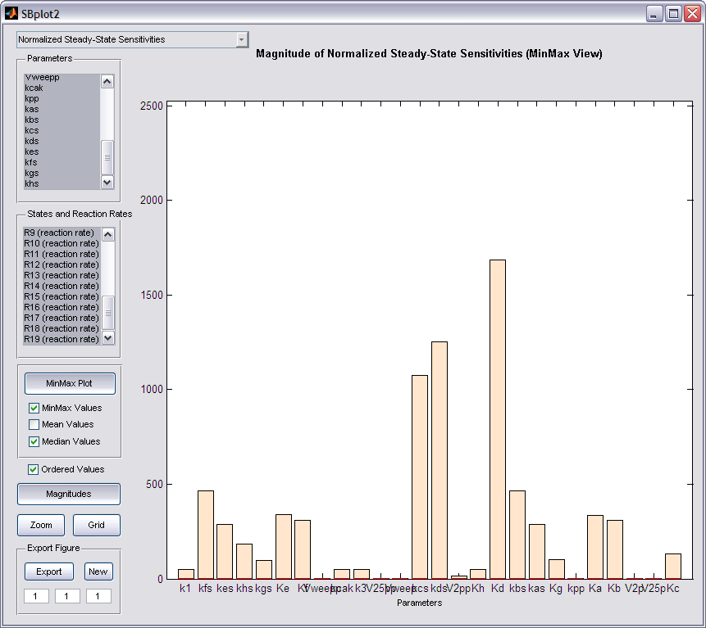
Local Parameter Sensitivity Analysis
Steady-State
IQMplot2
Graphical User Interface
allowing to display block
diagram type of data
Play around with the GUI
to get a feeling for its use

Slide 64
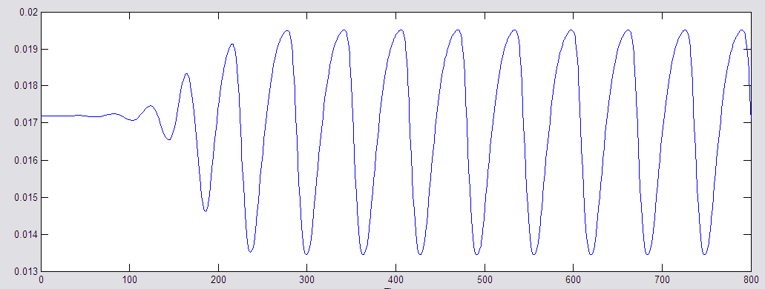
Local Parameter Sensitivity Analysis
Oscillating Systems (Period and Amplitude)
How is it implemented?
output = IQMsensdataosc(model,timeData)
timeData = [timeHorizont nrTransientHorizont]
timeHorizont * nrTransientHorizont
timeHorizont
(getting mean values)
timeHorizont
(collecting data)
•
•
•
t=0: Instant of
parameter perturbation

Slide 65
Local Parameter Sensitivity Analysis
Oscillating Systems (Period and Amplitude)
Simulate the model to determine the time needed for the transients to die out and the time needed to have several oscillations within the horizont
>> model = IQMmodel('CellCycleRed.txt')
>> output = IQMsensdataosc(model,[200 2])
output =
model: [1x1 IQMmodel]
time: [1x1001 double]
tenom: {1x9 cell}
tepert: {1x26 cell}
states: {9x1 cell}
xnom: [1001x9 double]
xpert: {1x26 cell}
parameters: {26x1 cell}
nomvalues: [1x26 double]
pertSize: [1 1 1 1 1 1 1 1 1 1 1 1 1 1 1 1 1 1 1 1 1 1 1 1 1 1]
absRel: [1 1 1 1 1 1 1 1 1 1 1 1 1 1 1 1 1 1 1 1 1 1 1 1 1 1]

Slide 66
Local Parameter Sensitivity Analysis
Oscillating Systems (Period and Amplitude)
Determining and displaying sensitivities
Accessing sensitivity data
>> IQMsensperiod(output) % display parameter sensitivities for the oscillation period
>> IQMsensamplitude(output) % display parameter sensitivities for the oscillation amplitude
>> sensdata = IQMsensperiod(output)
sensdata =
S: [9x26 double]
statesS: {9x1 cell}
parametersS: {26x1 cell}
Sn: [9x26 double]
statesSn: {9x1 cell}
parametersSn: {26x1 cell}
>> sensdata = IQMsensamplitude(output)
...

Slide 67
Metabolic Control Analysis
MCA is a special case of sensitivity analysis
Function: IQMmca
  Flux Control Coefficients
  Concentration Control Coefficients
  Elasticity Coefficients
The analyzed model needs to contain irreversible reactions only!
>> model = IQMmodel('CellCycleRed.txt') % load model
>> modelIR = IQMmakeirreversible(model) % make reversible reactions irreversible
>> ouput = IQMmca(modelIR) % perform MCA
states: {9x1 cell}
reactions: {23x1 cell}
FCC: [23x23 double]
CCC: [9x23 double]
EC: [23x9 double]

Slide 68
Global Sensitivity Analysis
4 global sensitivity algorithems implemented
  IQMsensglobalfast - Extended FAST
  IQMsensglobalprcc - PRCC (Partial Rank Correlation Coefficient)
  IQMsensglobalsobol - Sobols method
  IQMsensglobalwals - WALS (weighted average of local sensitivities)
(output = ) IQMsensglobalfast(model,timevector)
(output = ) IQMsensglobalfast(model,timevector,paramNames)
(output = ) IQMsensglobalfast(model,timevector,paramNames,OPTIONS)
Syntax
OPTIONS.statenames: cell-array with state names which to consider as model outputs
OPTIONS.variablenames: cell-array with variable names which to consider as model outputs
OPTIONS.reactionnames: cell-array with reaction names which to consider as model outputs
OPTIONS.Nsim: Number of simulation to carry out (approximate value)
OPTIONS.range: Order of magnitude of parameter perturbations
OPTIONS.firstorder: =0: use total effect, =1: use first order approx.
OPTIONS.objectivefunction: 'relative' or ' absolute'
OPTIONS.integrator: Structure with optional settings for the integrator
OPTIONS

Slide 69
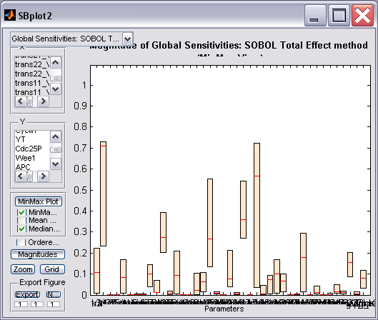
Global Sensitivity Analysis
Example
Running global sensitivity analysis on the Cell-cycle model
>> model = IQMmodel('CellCycle.txt'); % load the model
>> time = [0:2:400]; % define time vector
>> parameters = IQMparameters(model); % define the parameters to consider
>> OPTIONS = [];
>> OPTIONS.statenames = IQMstates(model); % define all states as output variables
>> OPTIONS.Nsim = 1000; % around 1000 simulations
>> OPTIONS.range = 1; % order of magnitude of perturbation
>> IQMsensglobalprcc(model,time,parameters,OPTIONS) % run PRCC method
>> IQMsensglobalsobol(model,time,parameters,OPTIONS) % run Sobol’s method
>> IQMsensglobalfast(model,time,parameters,OPTIONS) % run FAST method
>> IQMsensglobalwals(model,time,parameters,OPTIONS) % run WALS method
>> output = IQMsensglobalprcc(model,time,parameters,OPTIONS) % don’t plot, just return data
Works with IQM Tools Lite only, but VERY slow
Presence of IQM Tools Pro accelerates it to be useful

Slide 70
Localization of Complex Behaviors
Schmidt, H., Jacobsen, E.W. (2004) Linear systems approach to analysis of complex
dynamic behaviours in biochemical networks, IEE Systems Biology, 1, 149-158

Slide 71
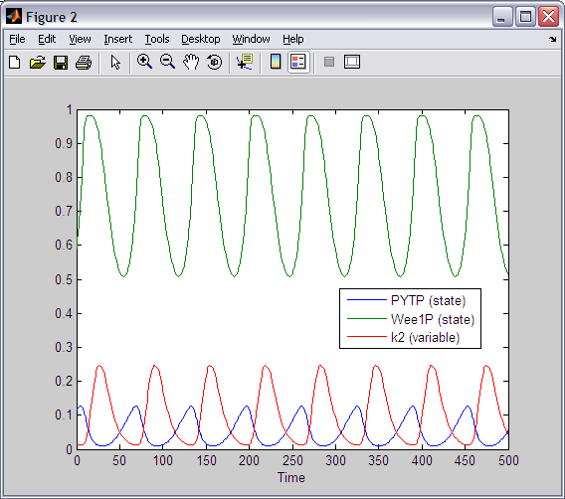
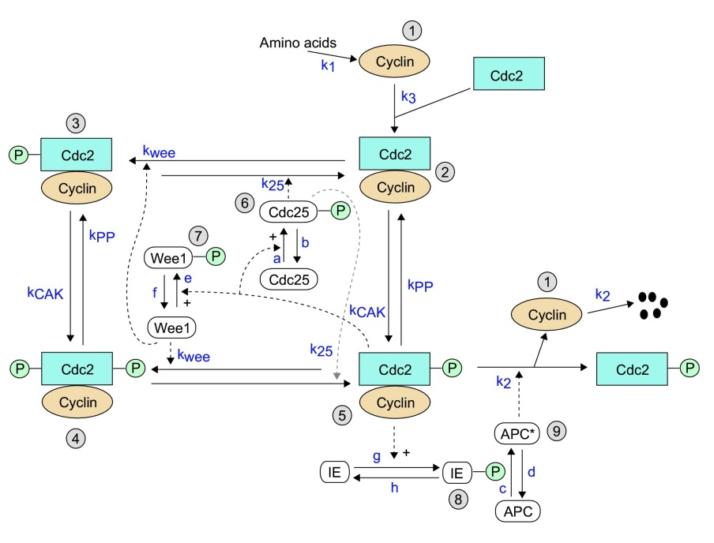
Localization of mechanisms leading to complex behavior
Which mechanism is the source of the oscillations?
>> model = IQMmodel('CellCycleRed.txt')
>> IQMsimulate(model,500)
?

Slide 72
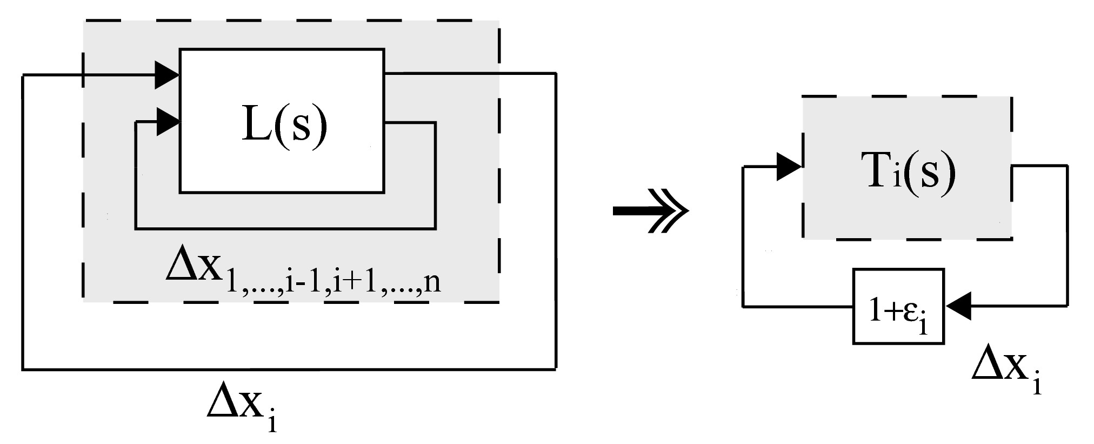
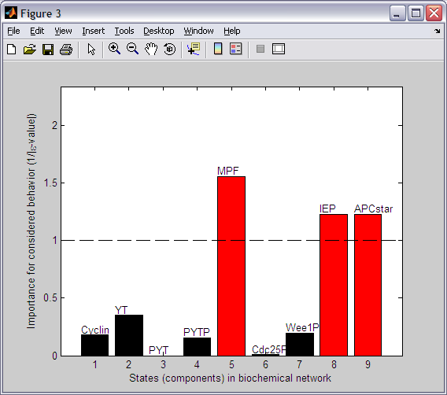
Localization of mechanisms leading to complex behavior
Importance of individual components / feedback signals
>> ss = IQMsteadystate(model)
>> IQMlocbehavcomp(model,ss)

Slide 73
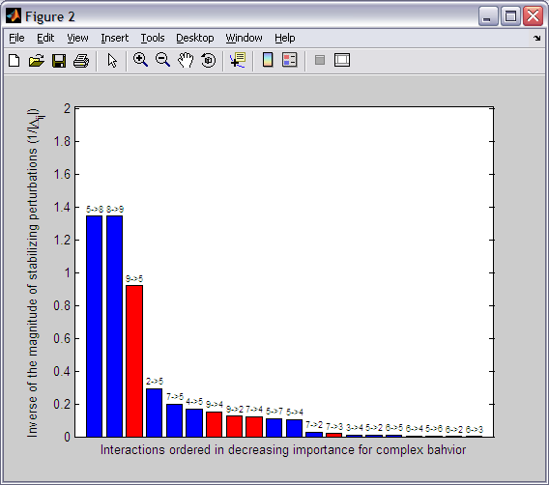

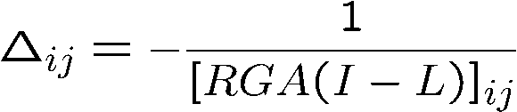
Localization of mechanisms leading to complex behavior
Importance of pairwise component interactions
L(s)
L_{p}(s)
>> ss = IQMsteadystate(model)
>> IQMlocbehavinteract(model,ss)

Slide 74

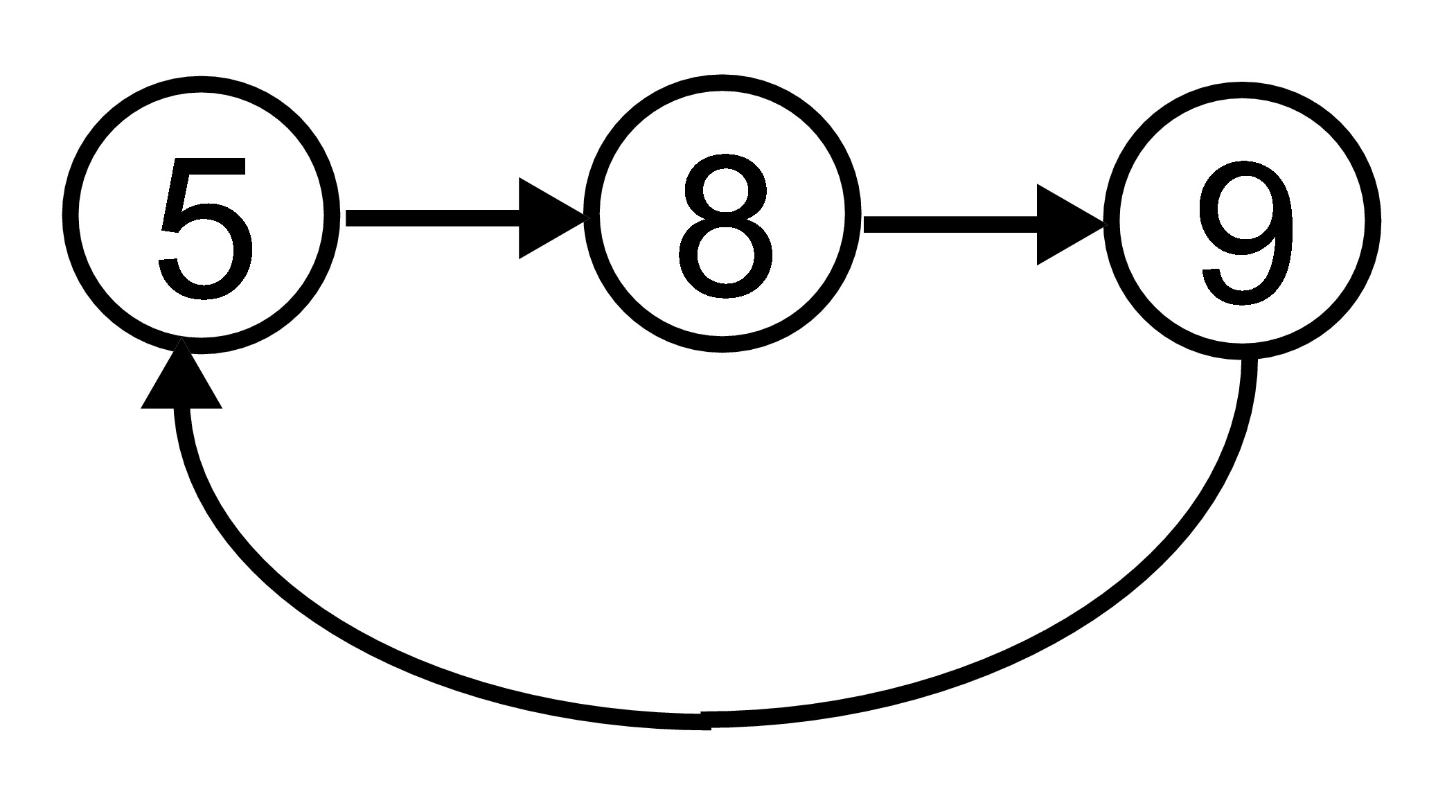
Identified mechanism behind oscillations
Feedback mechanism involving
  5: YTP
  8: IEP
  9: APC*

Slide 75
Tutorial Outline
General introduction to the IQM Tools Suite
Model definition and simulation
Model analysis
Model and dosing descriptions
  Setup models to defined dosing inputs
  Dosing description
  Simulation of dosing scenarios
Definition of experiments and measurement data

Slide 76
Representation of models
  Including INPUT and OUTPUT definitions in IQMmodel syntax
  Define parameters to be estimated and parameters to function as “regression” parameters

Slide 77
IQMmodel Syntax for dosing inputs and link to pharmacometric parameter estimation tools (used in IQM Tools Pro)
Same syntax as for IQMmodels
  ODEs or biochemical representation can be used
Additional elements
  INPUT*: Allows to define dosing inputs
  OUTPUT*: Allows to define outputs
********** MODEL NAME
Linear two compartmental distribution PK model
********** MODEL STATES
d/dt(Ac) = -CL/Vc*Ac – Q/Vc*Ac + Q/Vp*Ap + INPUT1
d/dt(Ap) = + Q/Vc*Ac - Q/Vp*Ap
********** MODEL PARAMETERS
CL = 20 % (L/hour) Clearance
Vc = 32 % (L) Central volume
Q = 12 % (L/hour) Intercompartmental clearance
Vp = 1450 % (L) Peripheral volume
********** MODEL VARIABLES
Cc = Ac/Vc % Calculation of plasma concentration
OUTPUT1 = Cc
Example model

Slide 78
IQMmodel Syntax - INPUTs
INPUT Definitions in IQMmodels
  Please open the example file inputExamples.m in the folder
  Example Files/MODEL_SYNTAX and work it through
  Example for a single input definition in an ODE based model (model1.txt)
  Example for a single input definition in an model based on biochemical reaction equations (model2.txtbc)
  Both models above are mathematically identical.
  The inputExamples.m file contains also a more complex input example
********** MODEL STATES
d/dt(Ac) = -VMAX*Cc/(KM+Cc) + F*INPUT1
********** MODEL REACTIONS
=> Ac : v_input
vf = F*INPUT1
Ac => : v_clearance
vf = VMAX*Cc/(KM+Cc)

Slide 79
IQMmodel Syntax - INPUTs
A model can contain arbitrarily many input definitions
INPUT* where "*": 1,2,3,4,5. Indices do not need to be sequential and do not need to start at 1, but they need to be numeric
Input definitions are only allowed in differential equations and in reactions
In the latter case the reaction name in the ODE is replaced by the reaction expression to have the input definition in the ODE
A prefactor is allowed, e.g. 1.5*INPUT1 or (k1+k2)*INPUT2 or F*INPUT4 No postfactors are allowed. A "*" character has to stand between prefactor and INPUT* definition
Input terms (INPUT* identifier and prefactor) are only allowed to be added (+) to the differential equation. But they can be the first term in the ODE, not requiring a leading "+" sign
If a parameter with the name "INPUT*" is defined in the model, its value will not be changed during import. If the model does not contain an INPUT* parameter, it is added and set by default to "0". INPUT* is only allowed to be defined as a parameter. Not as a variable and not as a reaction
Only parameters (and numerical values) are allowed to be used in the definition of INPUT* prefactors. But no states, variables and reactions
INPUT* definitions are not allowed to be enclosed in any parentheses

Slide 80
IQMmodel Syntax - OUTPUTs
OUTPUT Definitions in IQMmodels
  Please open the example file inputExamples.m in the folder
  Example Files/MODEL_SYNTAX and work it through
  Example for a single output definition in an IQMmodel (model1.txt and model2.txtbc)
The reason for the availability of these OUTPUT* definitions is that IQMtools uses these when interfacing IQM Tools with pharmacometric parameter estimation tools (NONMEM and MONOLIX)
The right hand side of OUTPUT* definitions should NOT contain mathematical expressions, but only get assigned previously defined variables (in this example: Cc)
********** MODEL VARIABLES
Cc = Ac/Vc % (ng/ml) Plasma concentration
OUTPUT1 = Cc % (ng/ml) Output variable

Slide 81
IQMmodel Syntax - OUTPUTs
OUTPUT* where "*": 1,2,3,4,5, ... In contrast to INPUT* definitions, the OUTPUT indices NEED TO BE sequential, starting from 1. No number is allowed to be excluded
Output definitions are only allowed to appear in the model variables section
The right hand side of OUTPUT* definitions should NOT contain mathematical expressions, but only get assigned previously defined variables
OUTPUT* variables are NOT allowed to depend on INPUT* components

Slide 82
IQMmodel Syntax – Parameter Info
The last elements of the IQMmodel syntax are flags that indicate if a certain parameter should be estimated or obtained from a dataset (called: regression parameter)
This is done by adding in
the comment section of a
parameter the reserved
words <estimate> or
<regression>
If a parameter is neither
estimated nor provided as
regression parameter, its
value will be kept on the
value defined in the model
itself
Note: this applies only to pharmacometric type of parameter estimation
Example Files/Model_Syntax/model_estimation.txt
********** MODEL PARAMETERS
% PK parameters obtained from dataset
F_subcut = 0.5 % <regression> (.)
CL = 0.303 % <regression> (L/day)
Vc = 2.83 % <regression> (L)
Q = 0.724 % <regression> (L/day)
Vp = 4.43 % <regression> (L)
VMX = 0.5 % <regression> (mg/day)
KM = 1.86 % <regression> (ug/ml)
% PD parameters to be estimated
BASELINE = 1 % (.)
kdeg = 0.1 % <estimate> (1/day)
EMAX = 1 % <estimate> (.)
EC50 = 1 % <estimate> (ug/ml)

Slide 83
Dosing scenarios
  Definition of dosing scenarios
  Simple simulation of dosing scenarios

Slide 84
IQMdosing Syntax
The IQM Tools allow to define dosing schedules in a simple but efficient format
The different dosing "inputs" then can be automatically applied to the inputs, defined in IQMmodels, using the INPUT* identifier
In this section we will explain how to define dosing schemes and how to merge them with models to simulate the desired dosing scheme on the desired model

Slide 85
IQMdosing Syntax
An example for a dosing scheme is the following
This dosing scheme defines that an INPUT1, defined in the model, should be implementing an infusion with a 14 day dosing interval, starting at time 0 with 5 repetitions, each dose 10 units and the infusion duration should be 2 hours
********** INPUT1
type: INFUSION
time: 0 % (days) time for first application
deltaT: 14 % (days) time inbetween applications
nr_repetitions: 5 % number of applications
D: 10 % (unit) dose
Tinf: 2/24 % (days) 2 hours

Slide 86
IQMdosing Syntax
Dosing schedules can be defined in several different ways, also different doses can be given at different times. The following dose-application-types can be defined:
  Bolus
  Infusion (both defining infusion rate or infusion time)
  0th-order Absorption
  1st-order Absorption
Optionally, each type can get a lag time assigned to it. Each dosing definition can define single doses or multiple doses

Slide 87
IQMdosing Syntax
Dosing definitions are contained in dosing files with the extension ".dos"
  ASCII text files which have a certain format and can contain an arbitrary number of input definitions
  Limitation: Each input definition needs to have a different name. For example "INPUT1" is not allowed to be defined more than once
Combining Models with Dosing Schedules
  The underlying idea is that a model, containing inputs (INPUT1, INPUT2, etc.) can be merged with a dosing description that defines these inputs to implement the corresponding dosing definitions. The result of this merge is again a model that now can be simulated
  Please open the example file dosingExamples.m in the folder
  Example Files/Dosing_Syntax and work it through

Slide 88
IQMdosing Syntax - Example
Assume you have the following model
And assume further that you want to
simulate a first order absorption in the
central compartment Ac
Then this is your dosing description
To merge model with dosing definition we need to
  1) Import the model
  2) Import the dosing definition
  3) Merge model with dosing definition to obtain a model for simulation
********** MODEL STATES
d/dt(Ac) = -VMAX*Cc/(KM+Cc) + F*INPUT1
********** MODEL PARAMETERS
VMAX = 1 % (ug/hour)
KM = 1 % (ng/ml)
Vc = 1 % (L)
F = 0.6 % (.)
********** MODEL VARIABLES
Cc = Ac/Vc % (ng/ml)
OUTPUT1 = Cc % (ng/ml)
********** INPUT1
type: ABSORPTION1
time: 0 % (hours)
D: 10 % (ug)
ka: 1 % (1/hour)

Slide 89
IQMdosing Syntax - Example
>> model = IQMmodel('model1.txt'); % Import of model
>> dosing = IQMdosing('dosing2.dos'); % Import of dosing description
>> modeldosing = IQMmergemoddos(model,dosing); % Merge model and dosing description:
Note the added elements and the naming of ka_input1, ...
********** MODEL STATES
d/dt(Ac) = -VMAX*Cc/(KM+Cc)+vAbsorption_input1 %(ug/hour)
d/dt(Comp_input1) = input1-vAbsorption_input1
********** MODEL PARAMETERS
VMAX = 1 %(ug/hour) Maximum rate of elimination
KM = 1 %(ng/ml) At this concentration elimiation rate is half VMAX
Vc = 1 %(L) Central volume
F = 0.59999999999999998 %(.) Relative bioavailability
Dose_input1 = 10
Time_input1 = 0
DeltaT_input1 = 0.0001
ka_input1 = 1
********** MODEL VARIABLES
Cc = Ac/Vc %(ng/ml) Plasma concentration
OUTPUT1 = Cc %(ng/ml) Output variable
vAbsorption_input1 = ka_input1*Comp_input1
input1 = +F*Dose_input1/DeltaT_input1 *
piecewiseIQM(1,andIQM(ge(time,Time_input1),lt(time,Time_input1+DeltaT_input1)),0)

Slide 90
Tutorial Outline
General introduction to the IQM Tools Suite
Model definition and simulation
Model analysis
Model and dosing descriptions
Definition of experiments and measurement data
  Excel and CSV measurement representation
  Experiment descriptions and merging with models
  Import and export measurements and experiments

Slide 91
Representation of measurement data
IQMmeasurement

Slide 92
Measurements
IQM Tools Lite can handle 2 representation formats
  Excel
  Comma separated values (CSV)
One Excel file can contain measurements of several experiments
One CSV file can contain measurements of a single experiment
Contents
  Name
  Notes
  Components (same names as model components)
  Componentnotes (additional information, e.g. units)
  Values

Slide 93
Measurement Examples and Import
Measurements in Excel
Measurements as CSV (importing CSV is MUCH faster then XLS)
Change into the ”Example Files” folder
Open the ”MeasurementExample.xls” in Excel
>> data = IQMmeasurement('MeasurementExample.xls')
data = [1x1 IQMmeasurement] [1x1 IQMmeasurement]
>> data = data{1} % use only first data object in the cell-array
WINDOWS ONLY
>> edit MeasurementExample.csv
>> data = IQMmeasurement('MeasurementExample.csv')
IQMmeasurement
==============
Name: MeasurementExampleCSV
Measured components: 3
Number time points: 42
Error bound information present at least for one measurement.
Measurements not present for all time points

Slide 94
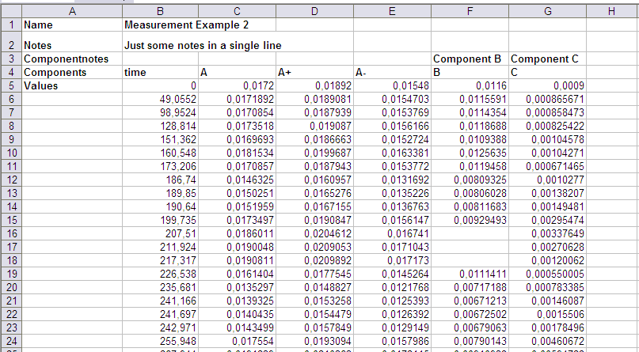
IQMmeasurements – Excel format
Measurement name
Notes about the measurement
Extra notes about the components
Names of the measured
components. ”time” appears here also in an arbitrary column
max (+) and min (-) values allowing the representation
of error bounds
Measurement data
Leave blank if unmeasured
Worksheets in an Excel book can contain any data. BUT if A1 is set to ”Name”
then the above format is expected.

Slide 95
IQMmeasurements – CSV format
[Name]
Measurement Example CSV
[Notes]
Notes about the measurement / experiment
[Components]
time,A,A+,A-,B,C
[Componentnotes]
A: Component A
B: Component B
[Values]
0, 0.0172, 0.01892, 0.01548, 0.0116, 0.0009
49.0552, 0.0171892, 0.0189081, , 0.0115591, 0.000865671
98.9524, 0.0170854, 0.0187939, NaN , 0.0114354, 0.000858473
128.814, 0.0173518, 0.019087, 0.0156166, 0.0118688, 0.000825422
151.362, 0.0169693, 0.0186663, 0.0152724, 0.0109388, 0.00104578
160.548, 0.0181534, 0.0199687, 0.0163381, 0.0125635, 0.00104271
Good practice
Give a useful name and
document the measurement data with telling notes
Measurement data
Leave empty or set to
NaN if unmeasured
Important:
The measurements should be given in units that are to be used for the models components!

Slide 96
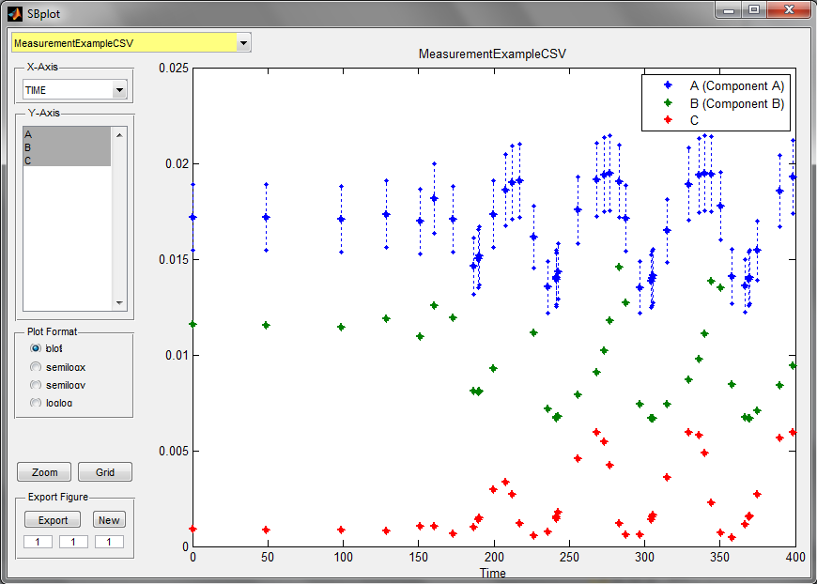
Handle Measurement Data
Visualizing the data
Extract information
>> IQMvisualizemeasurement(data)
>> [time, componentNames, values, minvalues, maxvalues] = IQMmeasurementdata(data)

Slide 97
Representation of in silico experiments
IQMexperiment

Slide 98
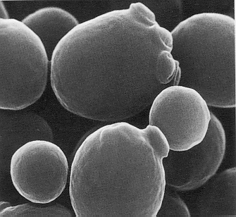
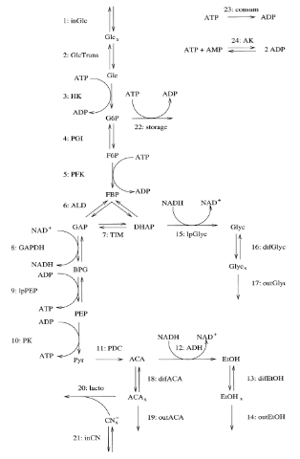
Experiment Descriptions
The System The Model
The Experiments
  Knockout
  Overexpression
  Change of concentration 1
  Change of concentration 2
  etc.
One slightly different
model for each experiment?

Slide 99
Experiment Descriptions – Why?
Typically many different biological experiments
Coding each experimental setting in the model leads to
  very complicated models or
  a large number of models to keep track of
Model
+
Experiment 1
manual coding
Model 1
Model
+
Experiment 2
manual coding
Model 2
Model
Working model
.
.
.
+
+
+
Model
+
Experiment N
manual coding
Model N
Experiment
Description 1
Experiment
Description 2
.
.
.
Experiment
Description N
automatic combination
Simulation
Model 1
Simulation
Model 2
Simulation
Model N

Slide 100
Experiment Descriptions
Experiment descriptions allow to define experimental settings insilico
Experiment descriptions in IQM Tools allow to
  change initial conditions
  change parameter values
  change parameter values over time
  change state variables at given time instants
A simple example
>> edit model1.txt
>> model = IQMmodel('model1.txt') % load the model
>> edit experiment1.exp
>> experiment = IQMexperiment('experiment1.exp') % load the experiment
>> modelexp = IQMmergemodexp(model,experiment) % combine model with experiment
>> IQMedit(modelexp) % have a look at the new model
Click ”Simulate”

Slide 101
Experiment Descriptions – How does it work?
********** MODEL NAME
Simple model
********** MODEL STATES
d/dt(A) = -R
d/dt(B) = R
A(0) = 1
B(0) = 0
********** MODEL PARAMETERS
k1 = 0.5
********** MODEL REACTIONS
R = k1*A
********** EXPERIMENT NAME
Simple Experiment for simple model
********** EXPERIMENT INITIAL PARAMETER AND STATE SETTINGS
k1 = 2
********** EXPERIMENT PARAMETER CHANGES
********** EXPERIMENT STATE CHANGES
time=10, A=1
********** MODEL NAME
Simple model
********** MODEL STATES
d/dt(A) = -R
d/dt(B) = R
A(0) = 1
B(0) = 0
********** MODEL PARAMETERS
k1 = 2
********** MODEL REACTIONS
R = k1*A
********** MODEL EVENTS
StateChange_1 = ge(time,10),A,1
The result is a
new model where
the experimental
settings have been
added

Slide 102
Experiment Descriptions
The general syntax is described in the experiment2.exp file
An experiment object is realized as an object of class IQMexperiment
>> edit experiment2.exp

Slide 103
Internal Experiment Data Structure
>> experimentstructure = struct(experiment)
experimentstructure =
name: 'Simple Experiment'
notes: 'Simple Experiment for Simple Model‘
paramicsettings: [1x1 struct]
parameterchanges: [0x0 struct]
stateevents: [1x1 struct]

Slide 104
Import/Export of measurement data
  CSV
  Excel

Slide 105
Measurements Export
Export a single measurement to an Excel file
Exporting several measurements to an Excel file
Export to CSV file
Import of data always by using the IQMmeasurement command
>> IQMexportXLSmeasurement(data, 'filename') % variable „data“ already defined
% from previous commands
>> IQMexportXLSmeasurements({data, data}, 'filename2') % just export twice the same data
>> IQMexportCSVmeasurement(data, 'filename')
>> data = IQMmeasurement('filename.csv') % imports the CSV file
>> datacellarray = IQMmeasurement('filename2.xls') % imports the Excel data file

Slide 106
Import/Export of experiment descriptions

Slide 107
Experiment Descriptions
Export of experiment descriptions
Import of experiment description files
>> IQMcreateEXPfile(experiment, 'experimentfile') % “experiment” defined from before
>> exp = IQMexperiment('experimentfile.exp')

Slide 108
Tutorial Goal: „You should now be able to“
Define models using ODEs and/or biochemical reactions
Simulate and analyze models
Simulate models for defined dosing inputs
Define and simulate experiments on models
Define measurement data, import, export, plotting

Slide 109
THE END
Thank you for your participation and interest!
The tutorial continues in Part 2 (IQM Tools Pro / MEX models, SB projects, parameter estimation)

